Slide 1
University Of Passau
Exchange Semester, Master, summer school

Slide 2

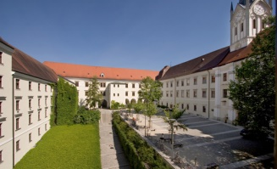
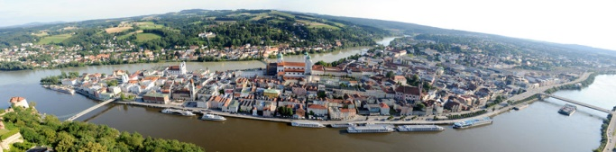
University of Passau

Slide 3
Student life in passau
Most of the students are living in a shared flat or students accomodation
You can find cheap meals at the canteen, but usually most students cook at home
There is no compulsory attendance for most of the classes ;) Sleep in, meet friends! :p
Main transportation is your bicycle and the public bus
Monthly you might need around 600 € (depending on accommodation, life style,…)
Language center and sport center

Slide 4
Exchange semester
4 students each academic year (Oct-Feb or April – July)
Students can attend all English courses offered at the university (not just the ones offered by your faculty!)
Your faculty at Atma Jaya (FISIP) can provide further information about the procedure of registration
Students accomodation is provided and the university staff will help you to find a room
Financing

Slide 5
Summer School
4 weeks during August
German Courses Passau
80 classes (45 minutes each); ca. 500 € + living costs
Courses are offered at different levels – also for beginners!
Also includes cultural activities and trips around Passau
Can be used to prepare further studies in Germany
Registration starts in April and ends in June
Scholarship: DAAD (www.daad.de)
Further information: http://www.gcp.uni-passau.de/en/summer-courses/

Slide 6
M.A. Development Studies
Deals with the economic, social, ethical, and cultural contexts and constraints of development.
Using quantitative and qualitative methods. Field research.
The aim is to understand and navigate the complexities of economic and social development.
Entirely taught in English
You can specialise in Development Economics or Southeast Asian Studies
Suitable for students with a B.A. in social sciences (e.g. sociology!) or economy

Slide 7
M.A. Governance and public policy
Governance research, basics of statehood, Good Governance, Comparative Politics/Global Governance, European Integration, Institutions and Political Change and Public Policy
Classes are held in English
Requirement: B.A. in social sciences or economics
Scholarship: DAAD PPGG (www.daad.de/ppgg)

Slide 8
Contacts
University of Passau: international@uni-passau.de
Southeastasian Faculties: Christa.Gottinger@uni-passau.de or Regina.Treipl@uni-passau.de
Marie: mariesprute@aol.com
Nadine: nadine.szemkus@yahoo.de

Slide 9
Sampai ketemu di Jerman!

